Slide 1
Chapter 1

Slide 2
User
Interface
Implementation
Operations

Slide 3
n
sqrt()
Square root of n

Slide 4
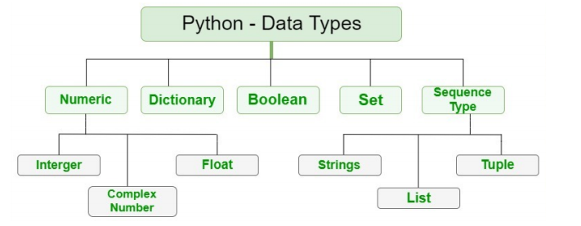

Slide 5
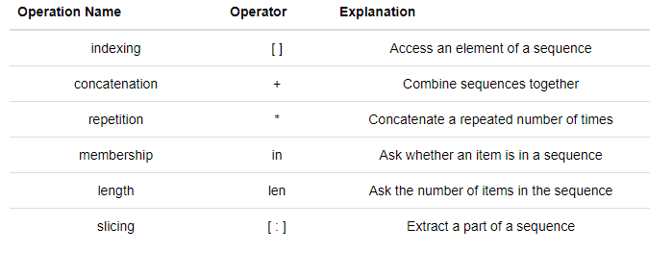

Slide 6
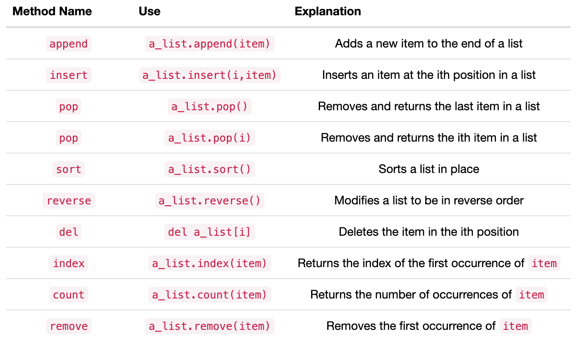

Slide 7
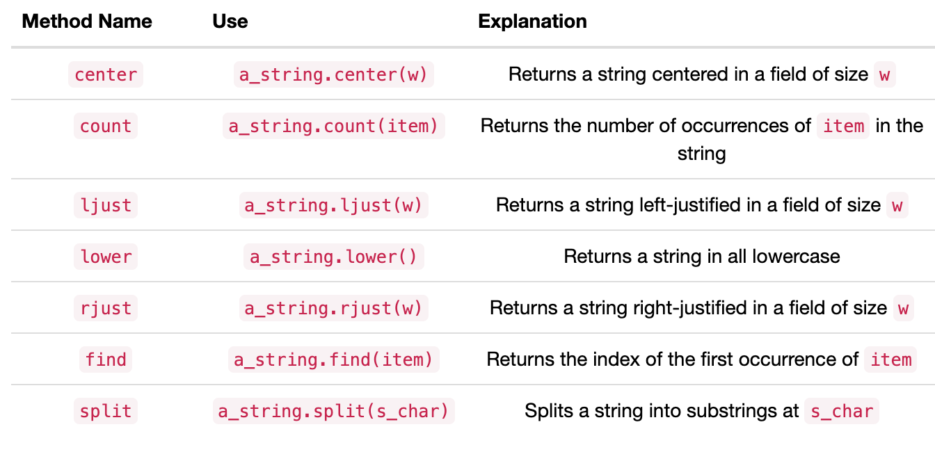

Slide 8
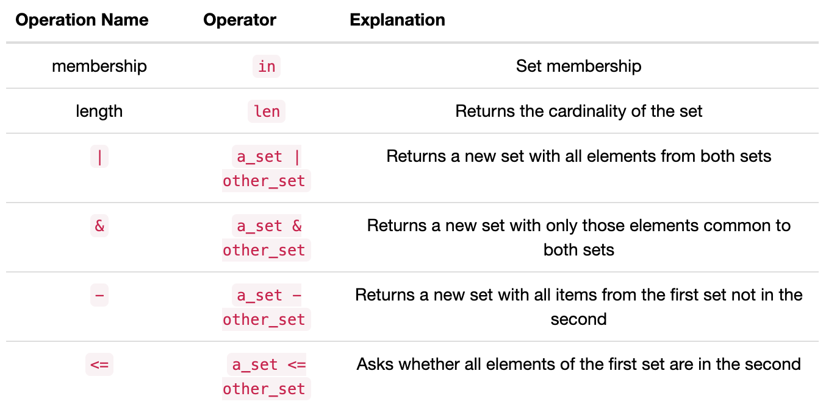

Slide 9
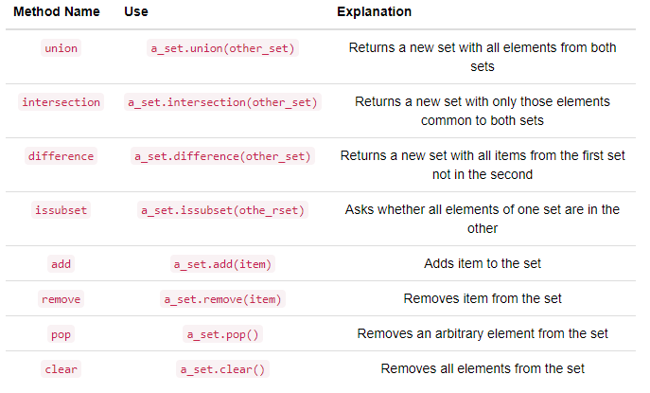

Slide 10
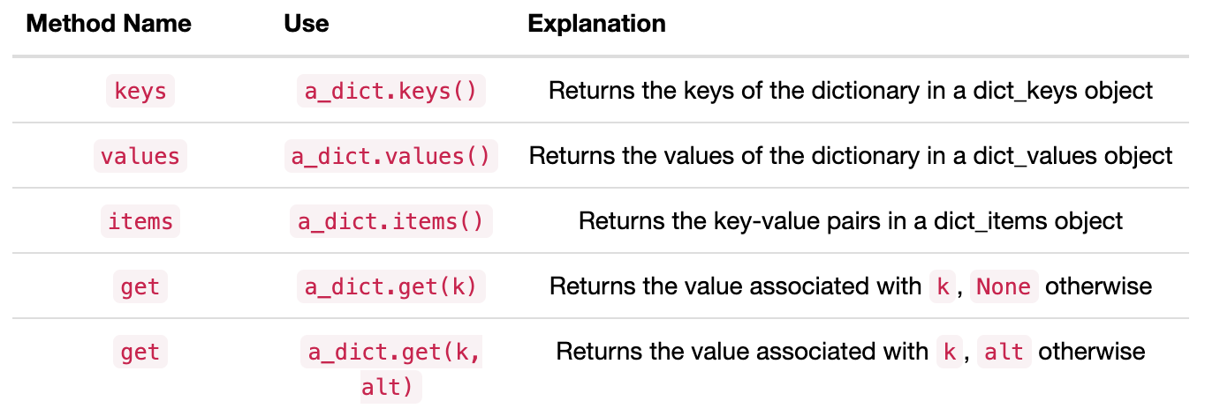

Slide 11
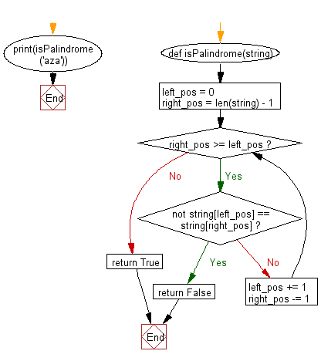

Slide 12
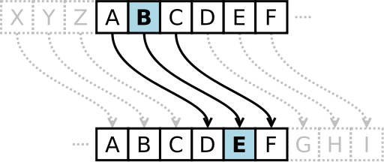

Slide 13
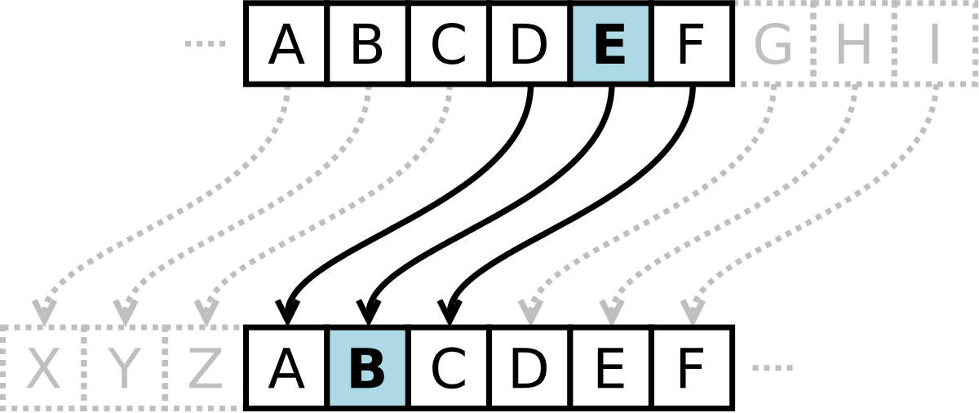

Slide 14


Slide 15
Methods
num
my_fraction
3
State
den
5

Slide 16
Shallow Equality
Methods
f1
num
3
State
den
f2
5
str
add
Methods
Deep Equality
Methods
f1
num
3
num
State
den
3
5
State
str
add
den
f2
5
str
add

Slide 17
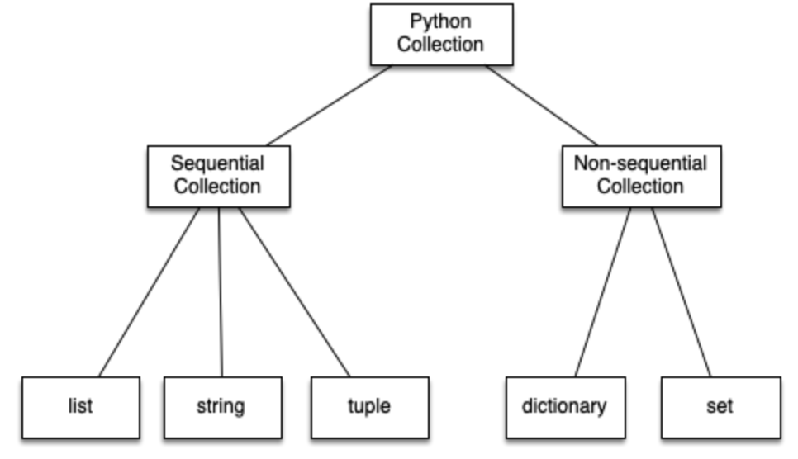

Slide 18
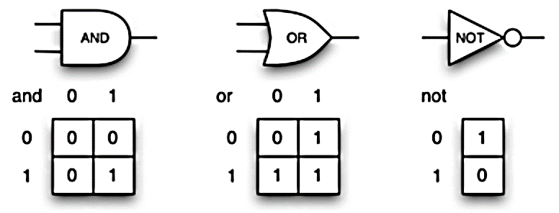

Slide 19
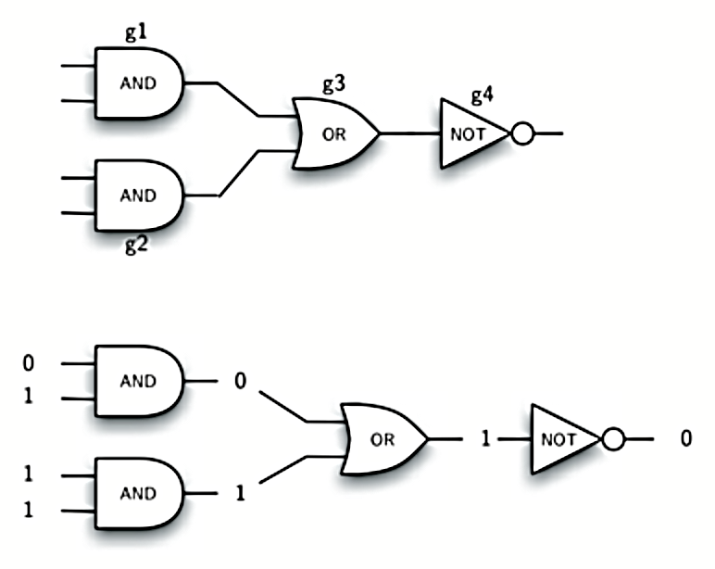

Slide 20
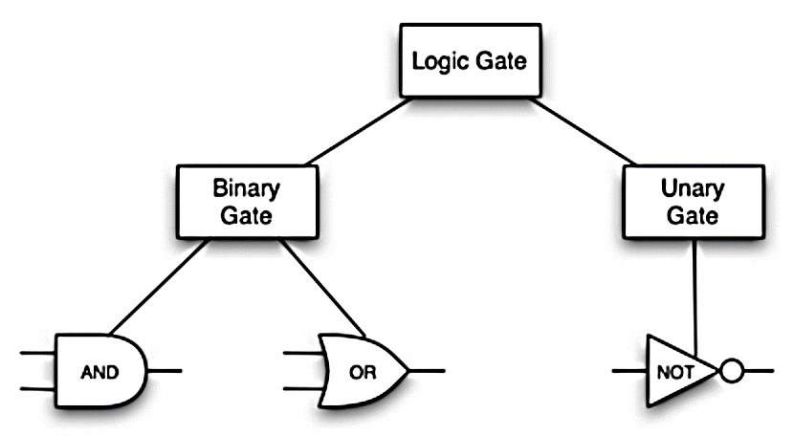

Slide 21
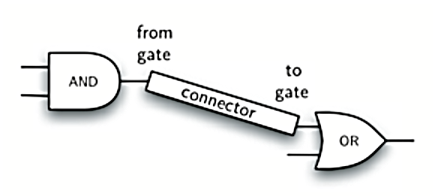

Slide 22


Slide 23
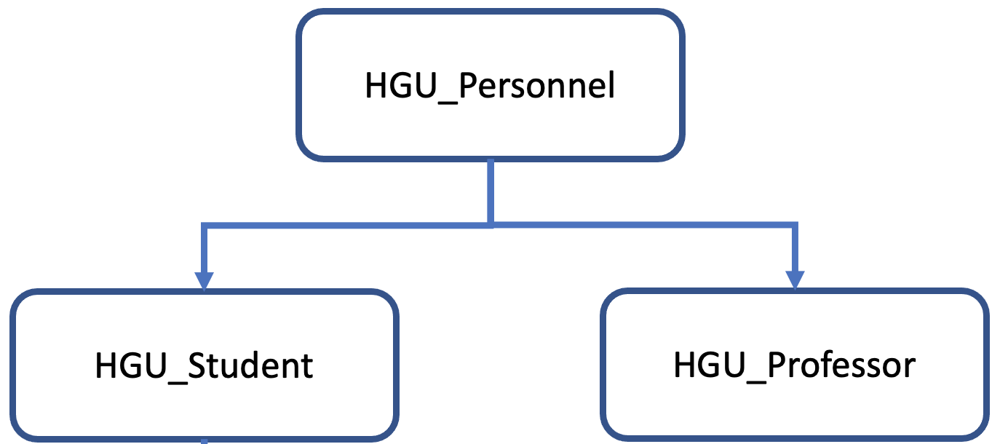

Slide 24
